Slide 1
UM CSE Undergraduate Override Project
Team Bae Squared:
Hilda Wang, Irene Bashar, Medha Kapoor, Preksha Shah
Notes:
Hilda Wang, Irene Bashar, Medha Kapoor, Preksha Shah

Slide 2

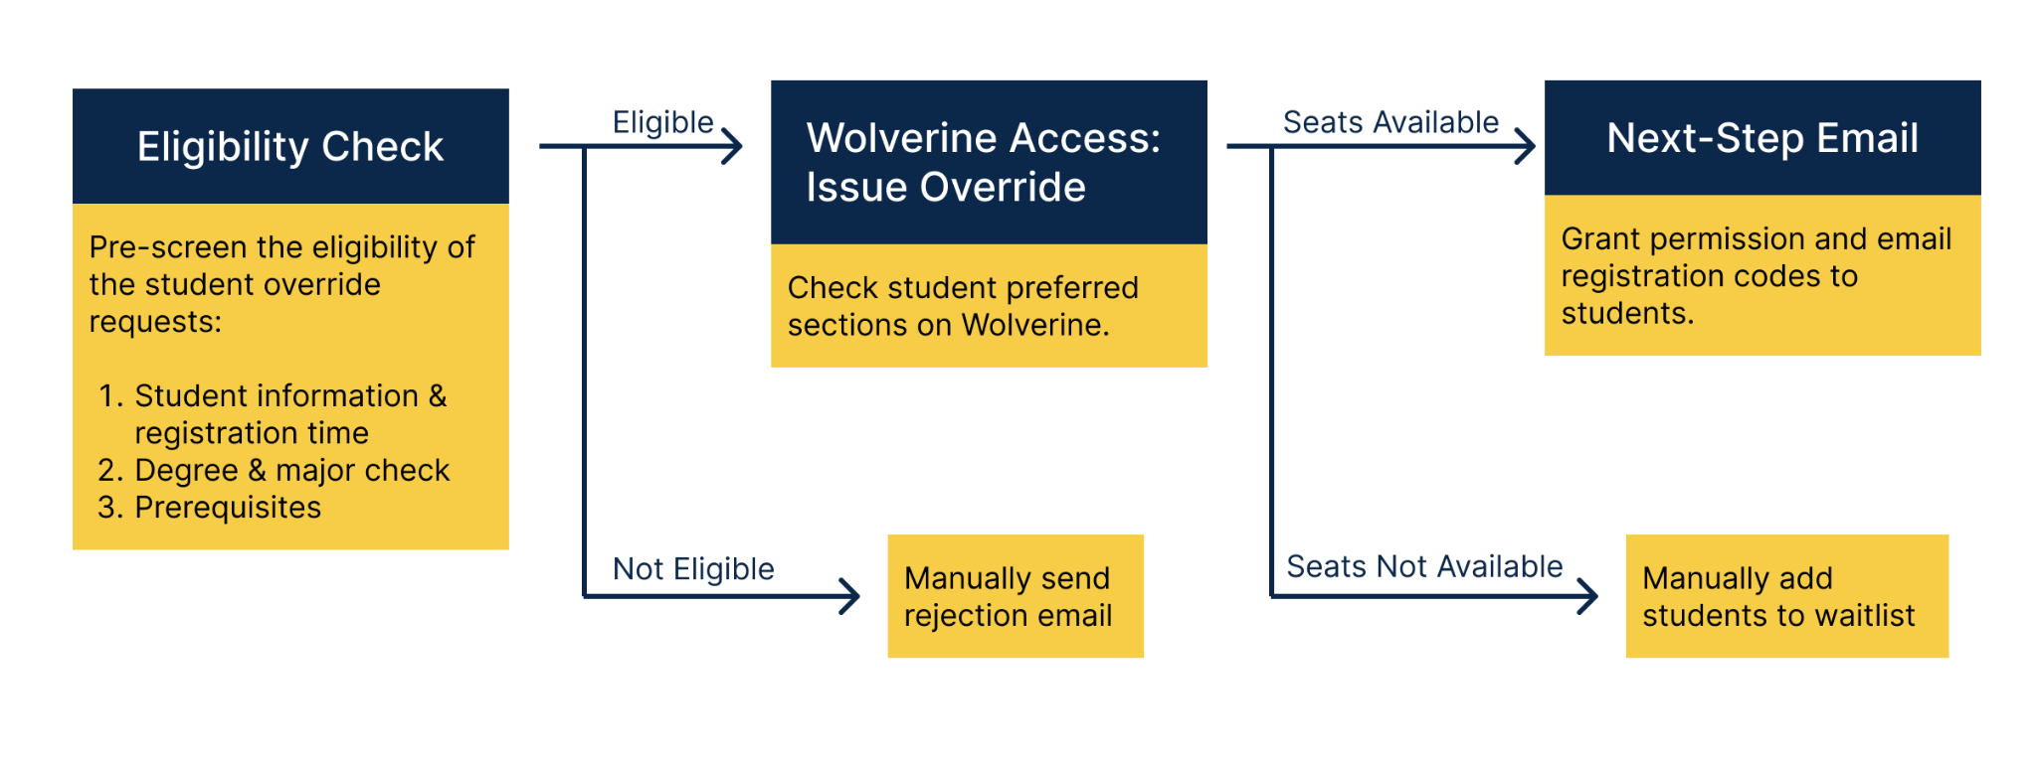
Client Mission
The UMich School of Computer Science & Engineering Undergraduate Advising Office, CSE UAO, assists students with various academic issues, such as course planning and applying for course overrides.
Notes:
preksha

Slide 3
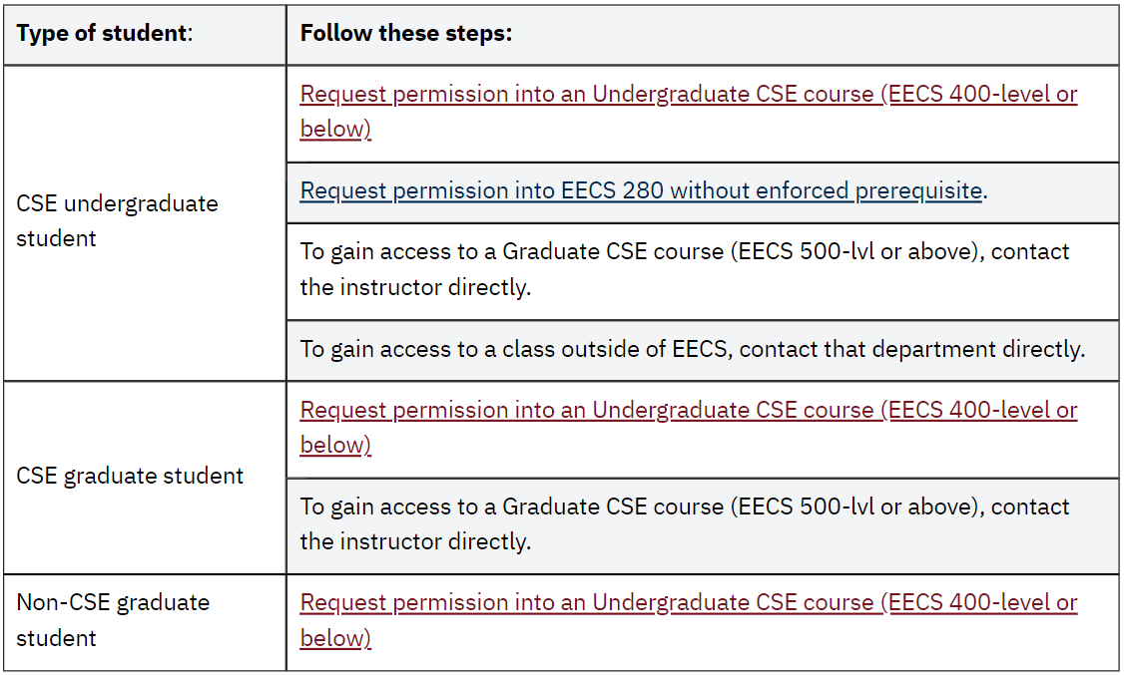
Client Problem Overview
In order to grant registration permission for students wanting to take a particular undergrad CSE class, UAO deals with a lengthy and disorganized course override process.
Numerous forms/spreadsheets
Having to manually input all the information.
Time consuming and increased chances of errors.
Involves drafting personalised emails every time request is rejected.
Only being able to grant one override request at a time even when a student requests multiple ones.
Present override forms
Notes:
medha
In order to gain a better understanding of our client’s problem, we spoke to a team of 6 CSE employees: 1 administrator, 4 advisors, and 1 programmer (who implemented a different override system for CSE).

Slide 4
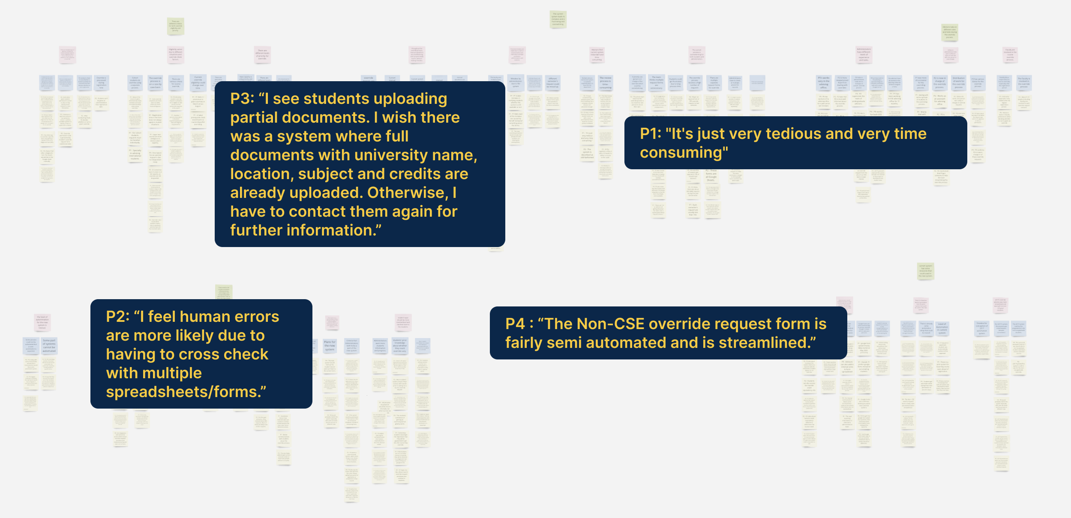
Quotes
Notes:
Medha
P1-Advisor P2-Advisor P3-Administrator P4-Programmeer
P1 "It's just very tedious and very time consuming".
P4 : “The Non-CSE override request form is fairly semi automated and is streamlined.”
P2: “I feel human errors are more likely due to having to cross check with multiple spreadsheets/forms”
P3: “I see students uploading partial documents. I wish there was a system where full documents with university name, location, subject and credits are already uploaded. Otherwise, I have to contact them again for further information”

Slide 5
Findings
There are different criteria for both override eligibility and priority.
Ex: faculty preferences, class capacity
The current system leads to mistakes and is frustrating and overwhelming.
Ex: too many forms and spreadsheets to go through, manual input mistakes (wrong UMID, mistakenly granting an override)
Existing technologies should also better incorporate what administrators wish to see in the new system.
Ex: More streamlining/automation implemented like current non-CSE override system - email dropdown menu, automatic notifications after form submission, as well as ML to help see prior cleared pre-reqs
Notes:
irene

Slide 6
Solution
Implementing the non-CSE override system:
Eliminates need for Google Forms
Reduces chances of making manual errors, due to less fields to fill out
Clarifies what student info needs to be inputted
Increases automation in process
Instructor is automatically notified about approving/rejecting request once student submits form
If instructor approves, UAO is automatically notified, allowing them to check for class capacity ASAP
Rejection and permission emails can be easily sent utilizing a drop-down email menu template, which has a set of pre-recorded personalised emails.
Utilizes a more personalized and secure platform, versus using Google Forms, which can pose a potential security risk.

Slide 7
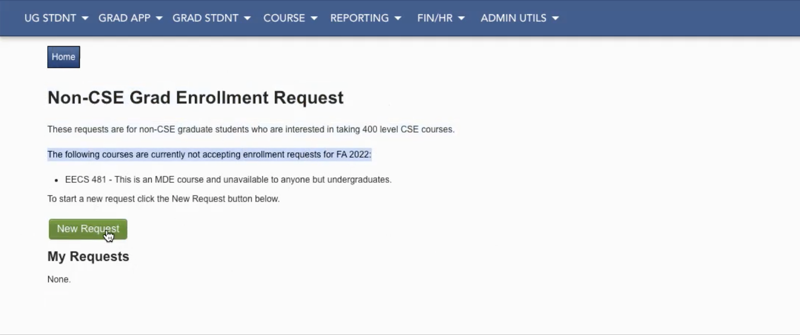
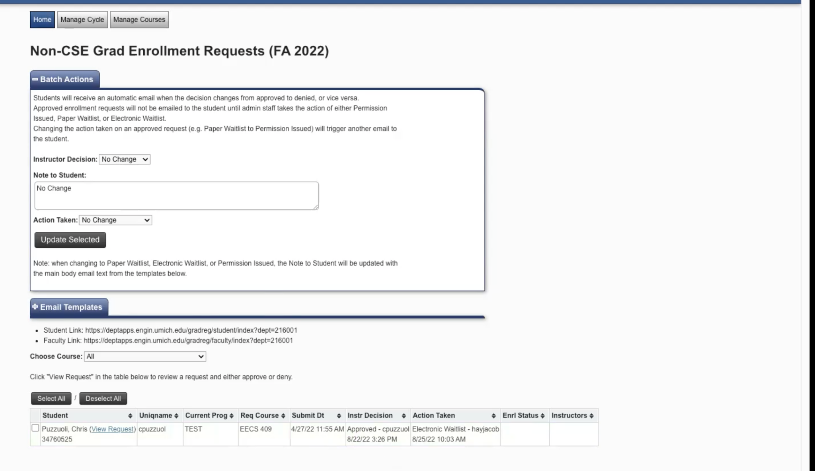
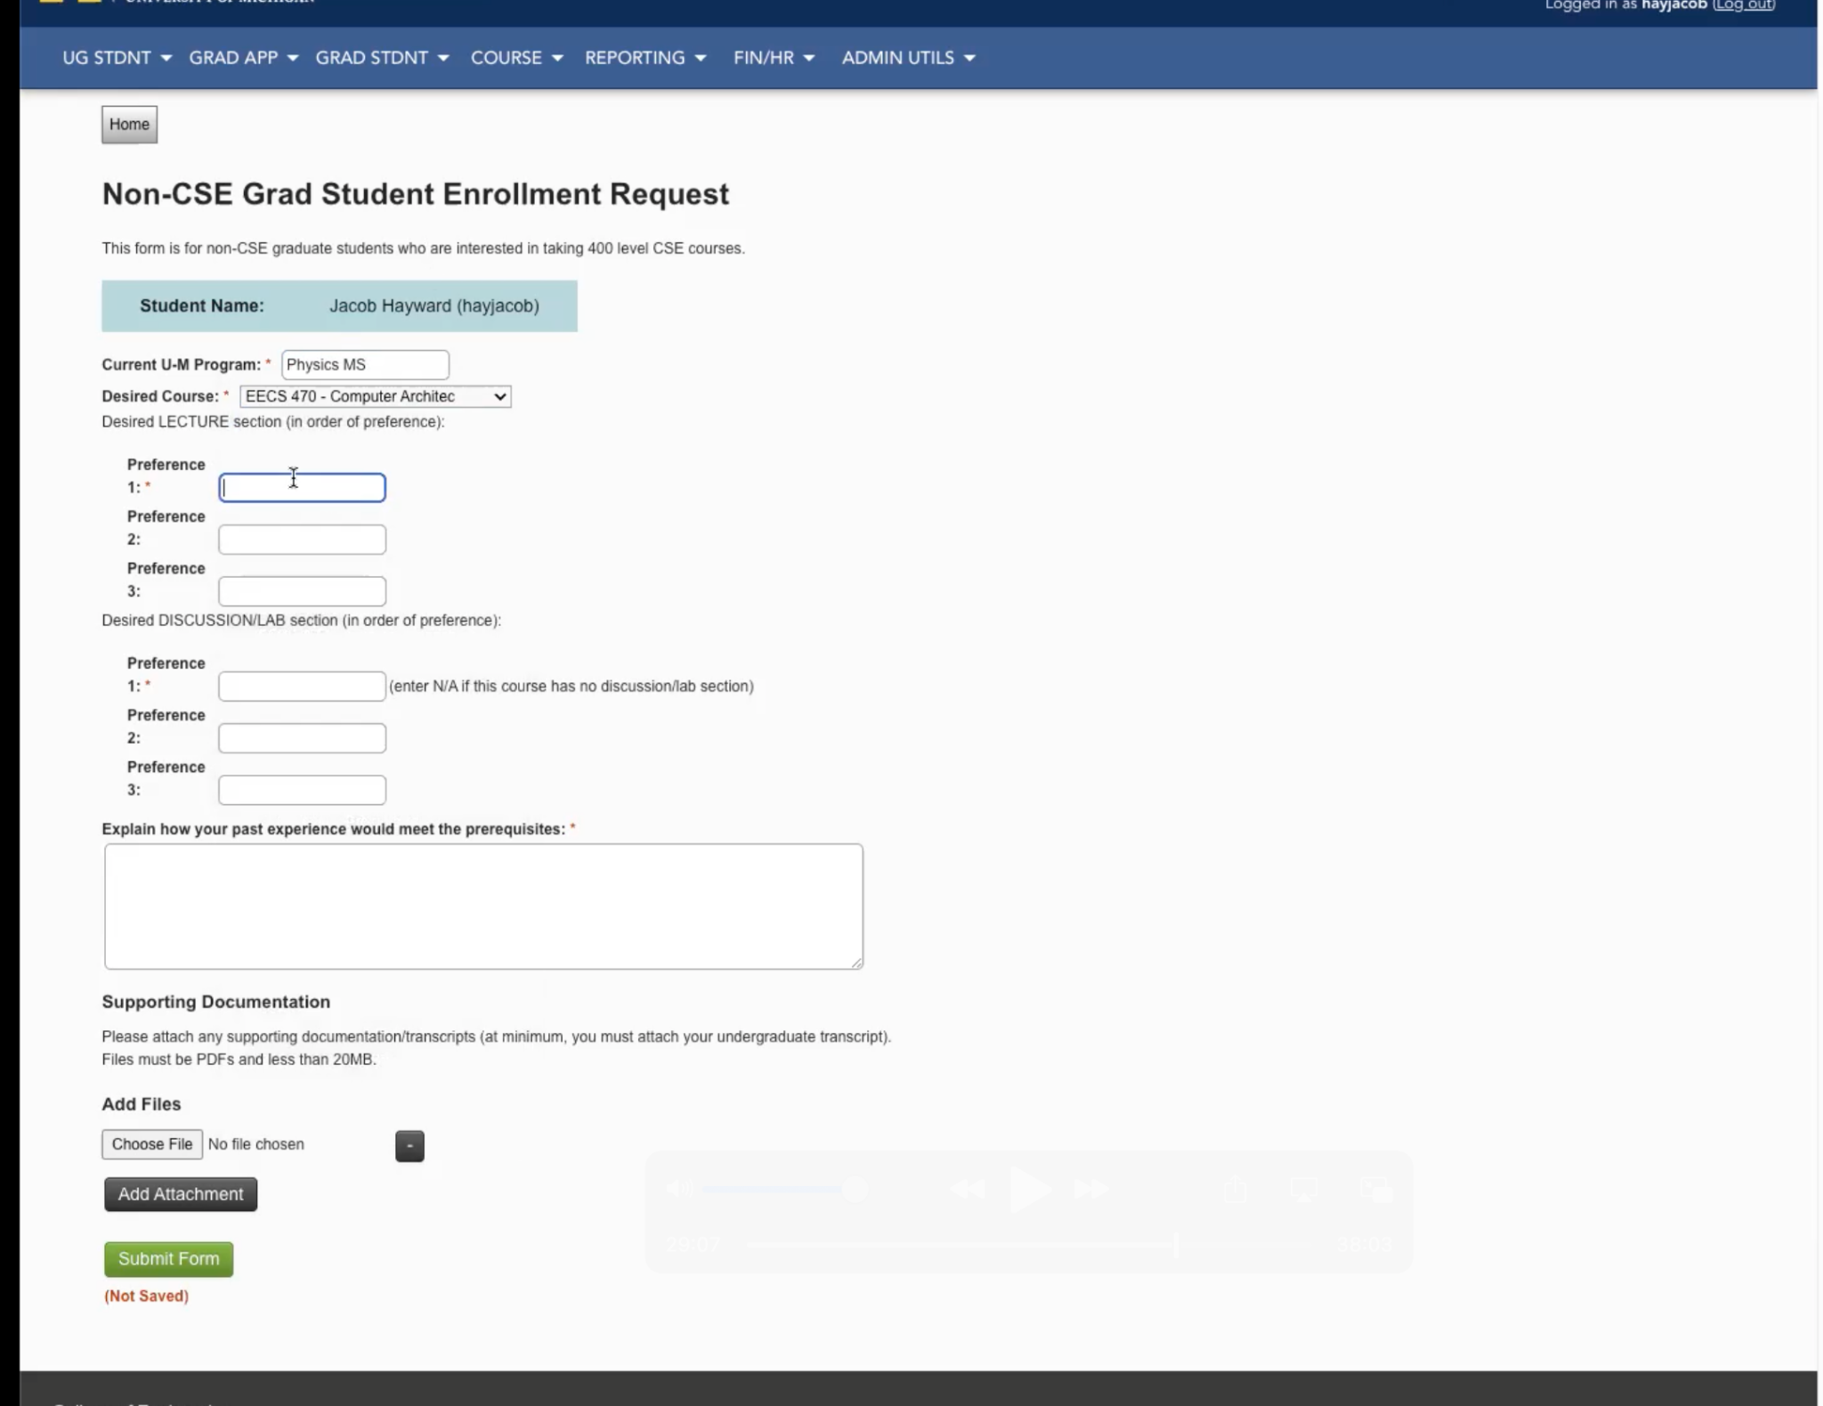
Non-CSE System:
Administrator Processing
Student Request Form

Slide 8
Future Steps
Integration for administrator side of data management
Integration of internal and external eligibility checking resources

Slide 9
Thank you!
Notes:
Hilda Wang, Irene Bashar, Medha Kapoor, Preksha Shah

